Slide 2
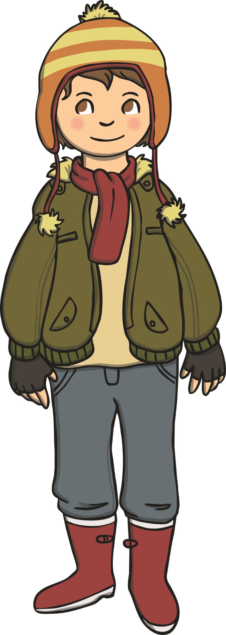
Hello! I am going on an autumn walk. I am wrapped up warm with my coat, hat and scarf.
On my walk I am going to use all of my senses. I have five different senses.
Can you guess what they are?

Slide 3

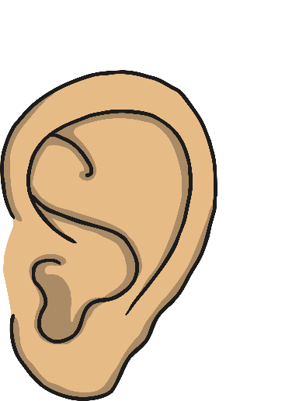
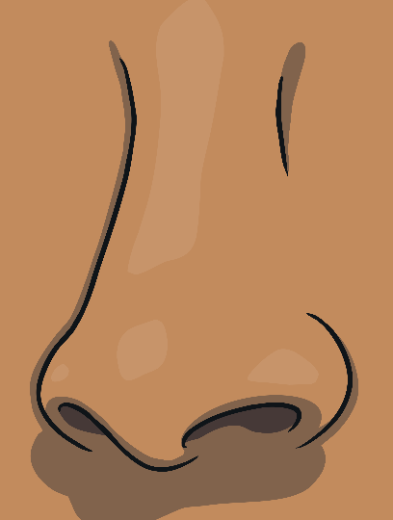


My Five Senses
Click on each one to find out more.
next

Slide 4


My Sense of Sight
I can see with my eyes.
My eyes tell me lots of things about the world around me.
I can see colours and shapes.
My eyes help me to see what things look like.
back

Slide 5
My Sense of Smell
There are lots and lots of different smells.
I smell with
my nose.
I can tell if something smells nice.
back
I can tell if something smells nasty.

Slide 6

My Sense of Hearing
Some sounds I like and some
I do not.
Some sounds are loud and some are quiet.
My ears help me to hear.
I hear sounds with
my ears.
back

Slide 7

My Sense of Touch
Touching something can tell me how it feels. It might feel smooth, spiky or maybe even slimy.
Touching something can tell me if it is hot or cold.
When I touch something, I can feel it.
back
I can use my hands to touch something.

Slide 8
My Sense of Taste
Tasting something tells me if something is sweet, spicy or salty.
My tongue helps me to taste something.
Some tastes I like and others I do not like.
Every time I eat something, my tongue is telling me how it tastes.
back

Slide 9


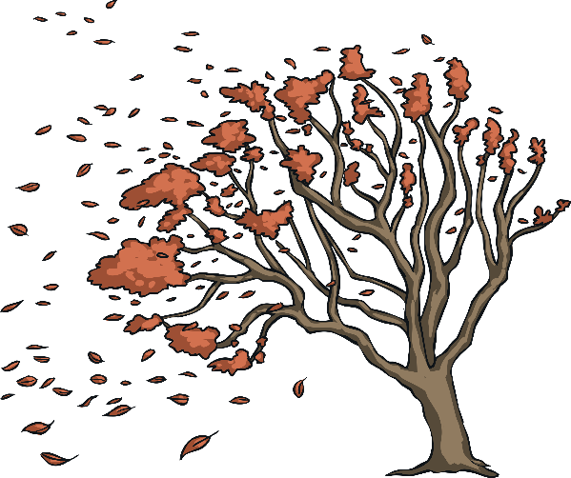

I use my sense of hearing to hear…
squirrels chattering in the trees
the rustle and crunch of autumn leaves under my feet
the wind blowing through the trees

Slide 10

I use my sense of sight to see…
the shiny, brown acorns
the red, yellow, brown, green and gold leaves
the bright orange pumpkins

Slide 11

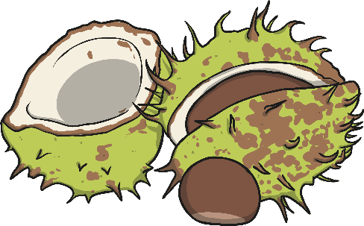
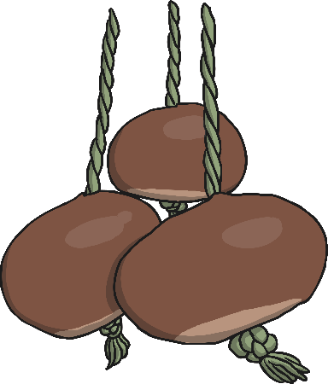

I use my sense of touch to feel…
the spiky shell of a conker
a smooth, shiny conker
the crisp and crunchy autumn leaves

Slide 12



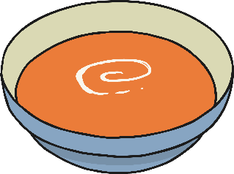
I use my sense of smell to smell…
the autumn rain
people making hot and yummy soup
autumn bonfires

Slide 13


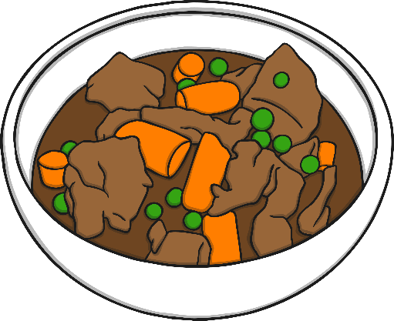
I use my sense of taste to taste…
some yummy, sweet blackberries
a delicious hot drink which warms me up
a delicious stew made with lots of fresh autumn vegetables

