Slide 2
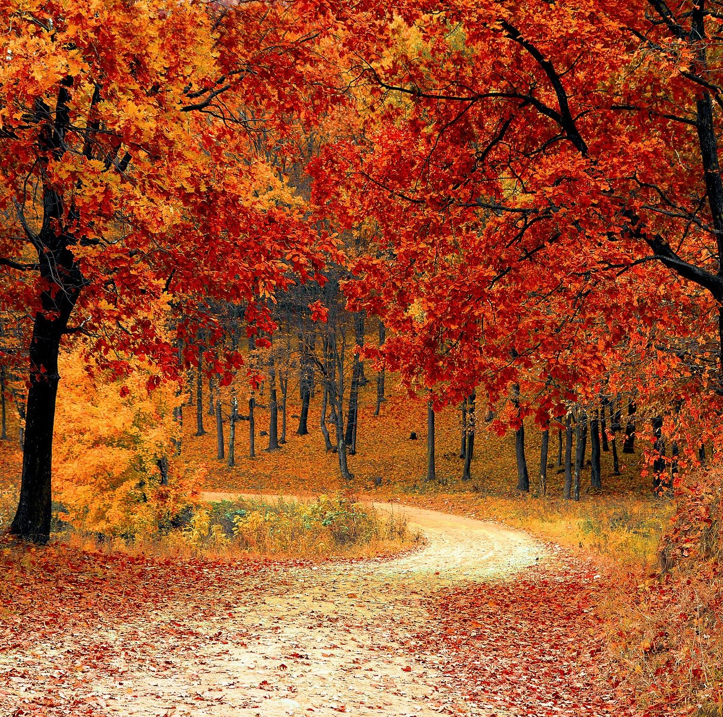
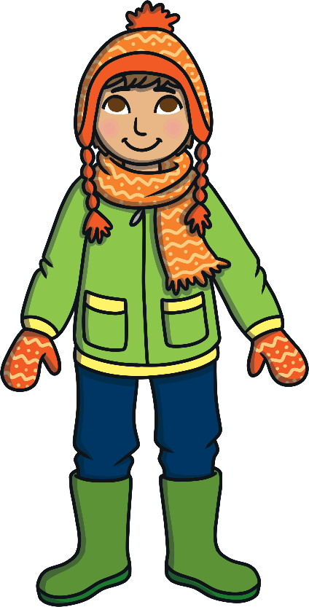
What is Autumn?
  Autumn is one of the four seasons.

Slide 3
What is Autumn?
  In countries in the northern hemisphere, such as the United Kingdom, autumn takes place in the months of September, October and November.

Slide 4
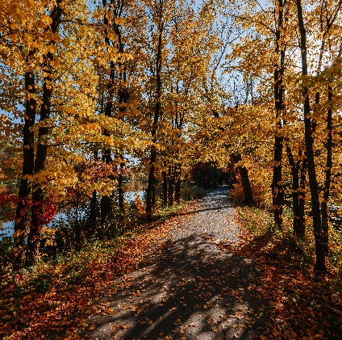
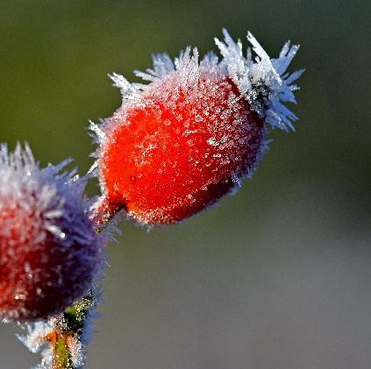
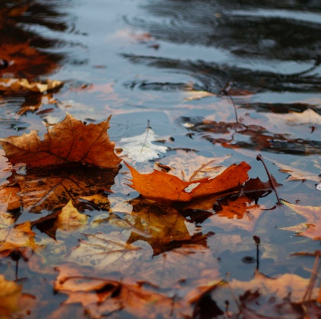
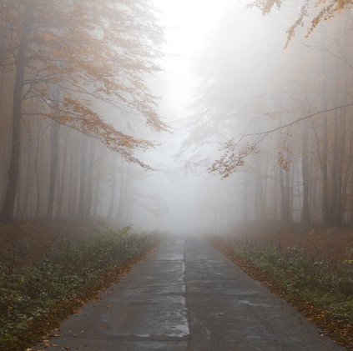
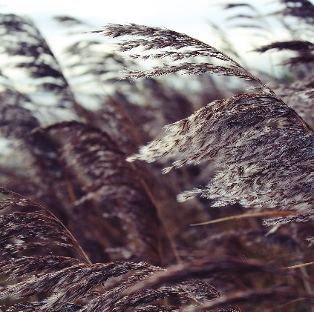
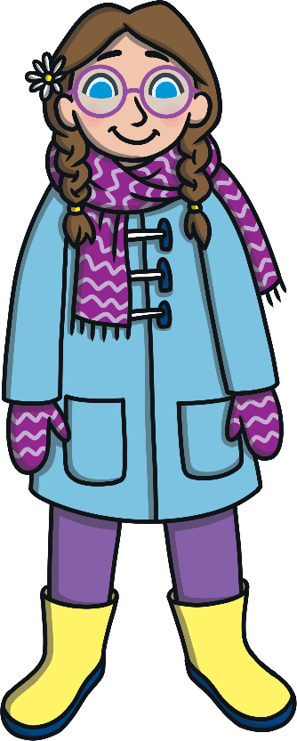
Weather in Autumn
The weather changes all the time in autumn. The weather gets cooler and days can be windy and wet. Some days can still be sunny and golden.
sunny
frosty
rainy
What clothes should we wear in autumn?
misty
windy

Slide 5
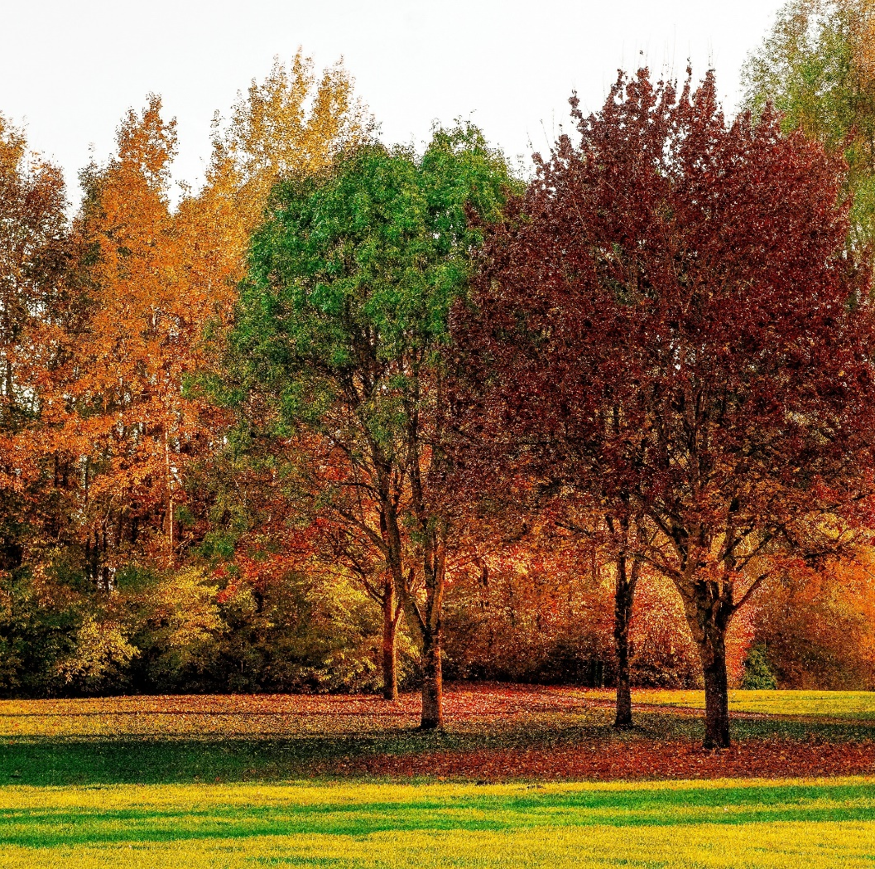
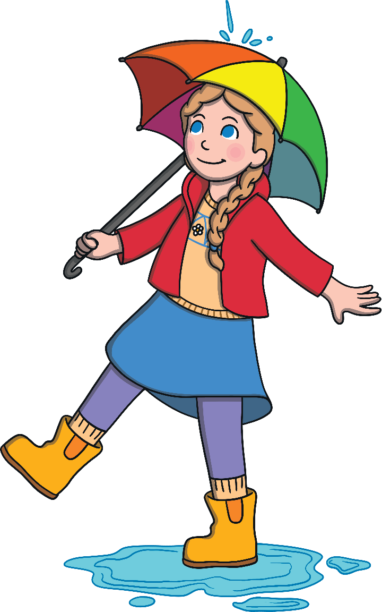
Colourful Trees
    Some leaves on trees start to change colour and fall off in autumn. These trees are called deciduous.
    Leaves can turn from green to orange, yellow, brown and even red.
    The leaves change colour because there is less light in autumn for the trees to keep making their leaves green.
Did you know that the word deciduous means to fall off or down?

Slide 6
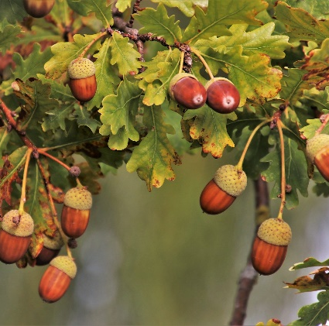
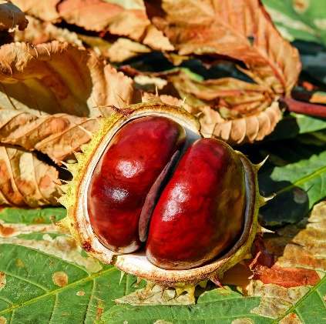
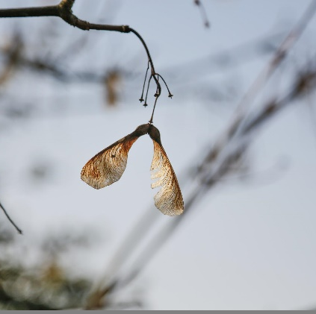
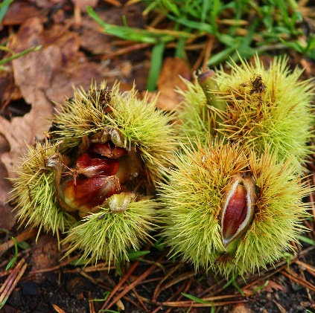
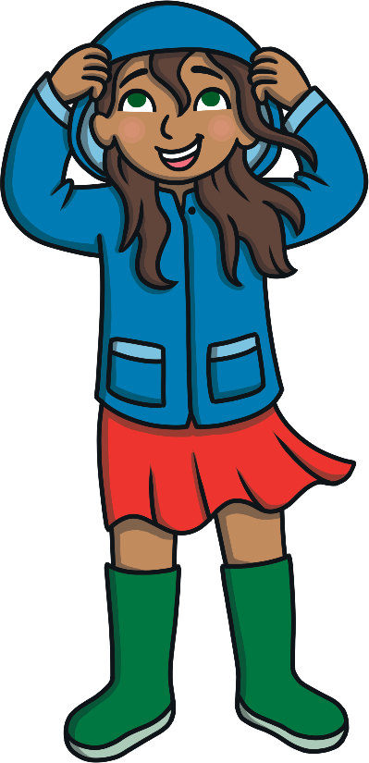
Seeds From Trees
    During autumn, seeds on trees ripen. This means they are ready to make a new plant, so they fall to the ground.
    Some seeds fall to the ground in hard, spiky shells which then split open. These shells help to protect the seeds.
  You may see some seeds twirling in the winds like helicopter blades.
Have you ever played with conkers?
Do you know the names of any of these seeds?

Slide 7
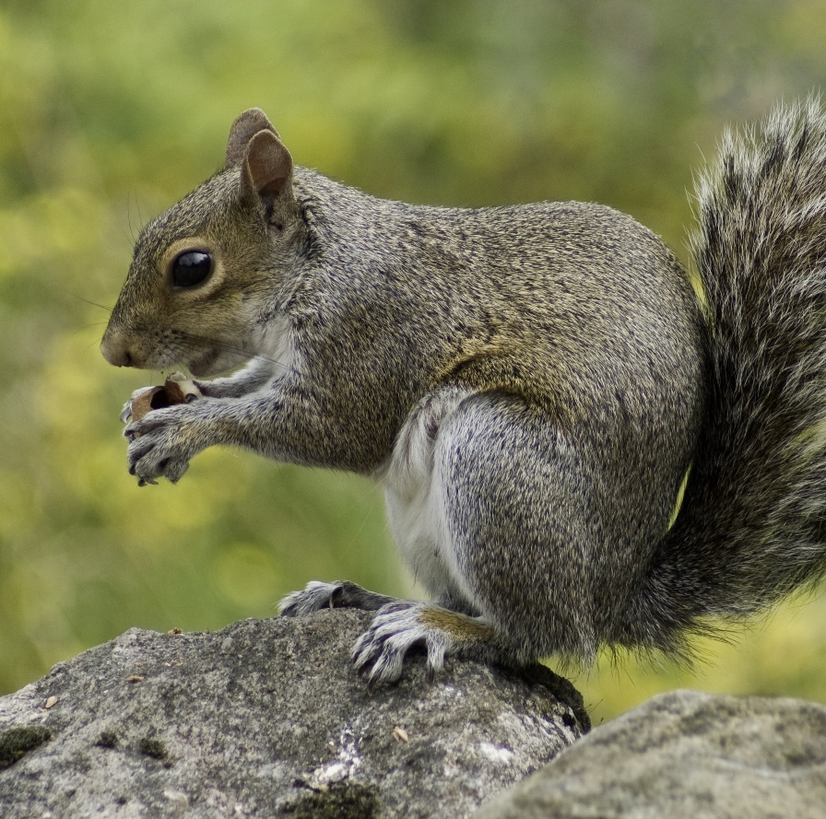
Animals in Autumn
Animals are very busy in autumn time preparing for the cold winter months ahead.
      Mice and squirrels collect lots of nuts and acorns. They hide them in the ground to eat during the winter.

Slide 8
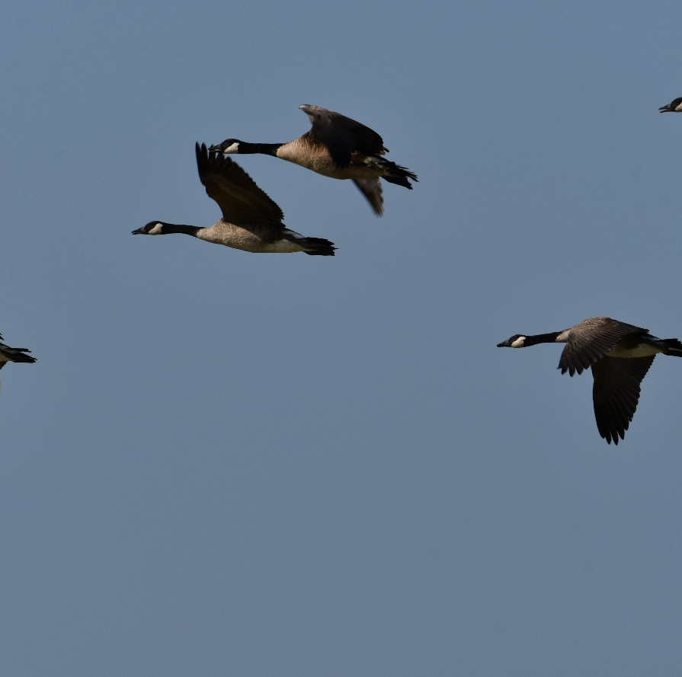
Animals in Autumn
Animals are very busy in autumn time preparing for the cold winter months ahead.
      Some birds migrate in autumn.
      This means they fly to warmer places to live until the spring.

Slide 9
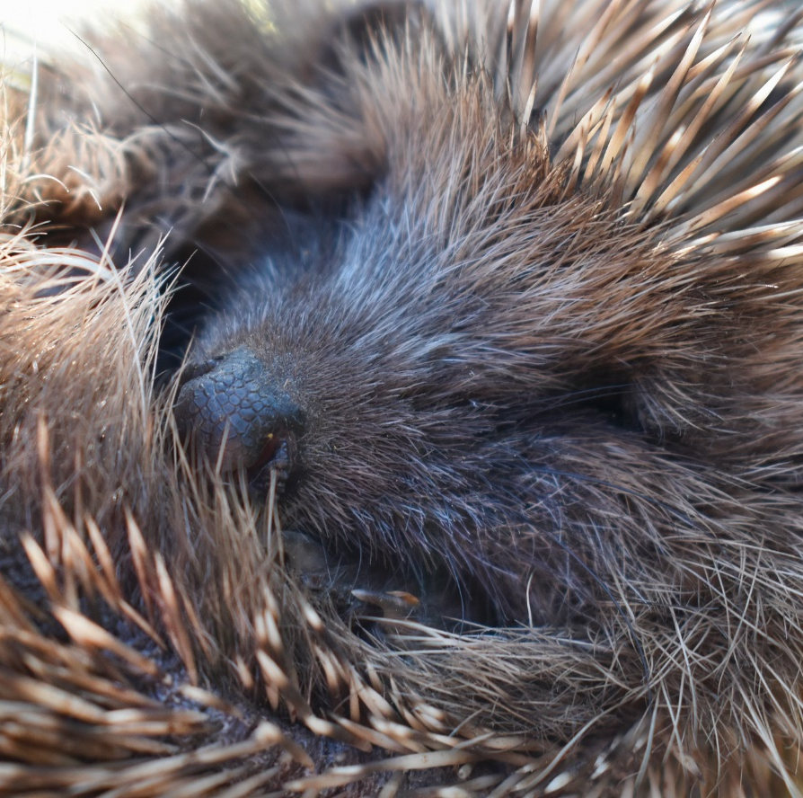
Hibernation
When the weather is cold and food is harder to find, some creatures decide to hibernate and enjoy a big winter sleep.
Hedgehogs make cosy nests to
hibernate in. They make them
inside compost heaps, in leaves
or in the roots of trees.

Slide 10
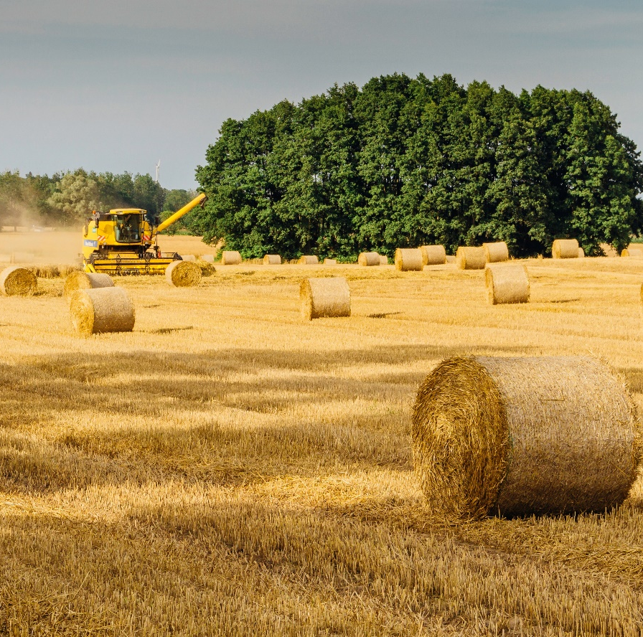
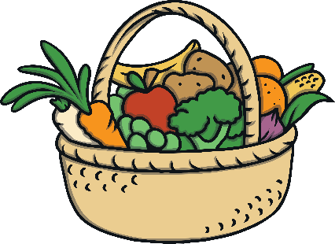

Harvest Time
      Harvesting happens in autumn.
      It is a very busy time for farmers.
      Harvesting means to collect anything that has been planted and grown in the ground like wheat, beetroot, potatoes, leeks, onion and carrots.
Some people celebrate this time of year with a Harvest Festival. It is a time to be thankful for all the food that they have grown.

