Slide 2
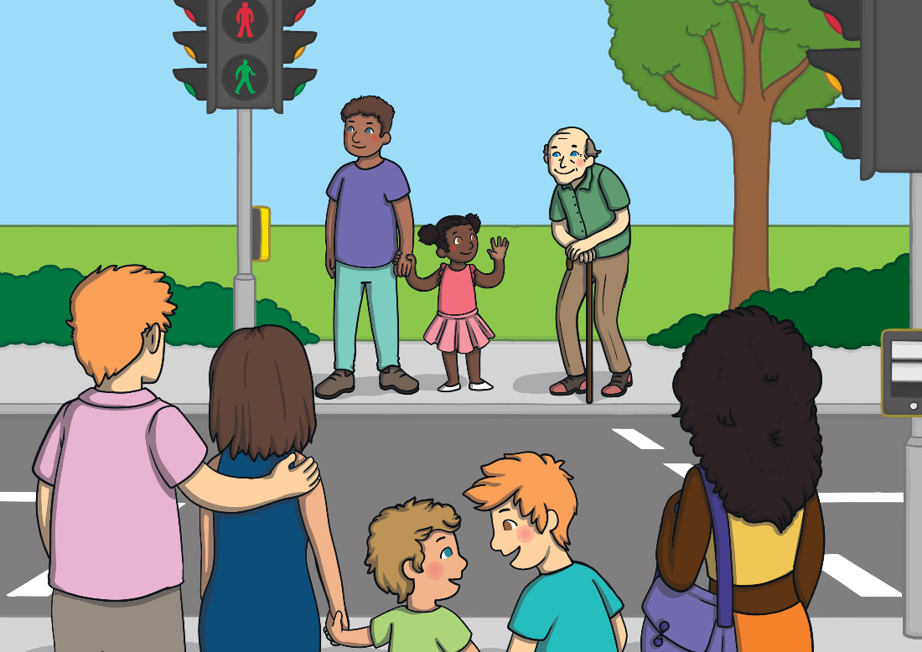
Road Safety
Crossing the road can be very dangerous. Adults can help you and there are some special rules to follow to make sure you can cross the roads safely.

Slide 3
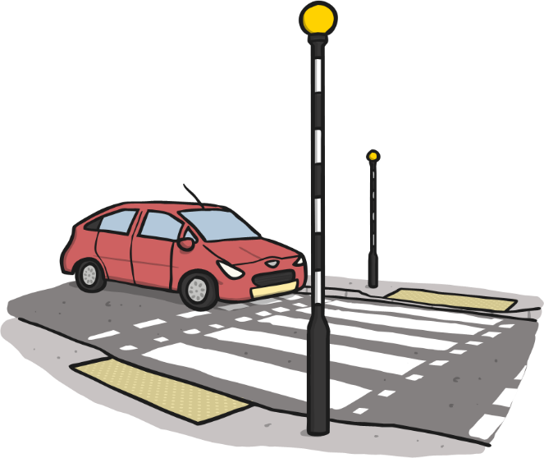
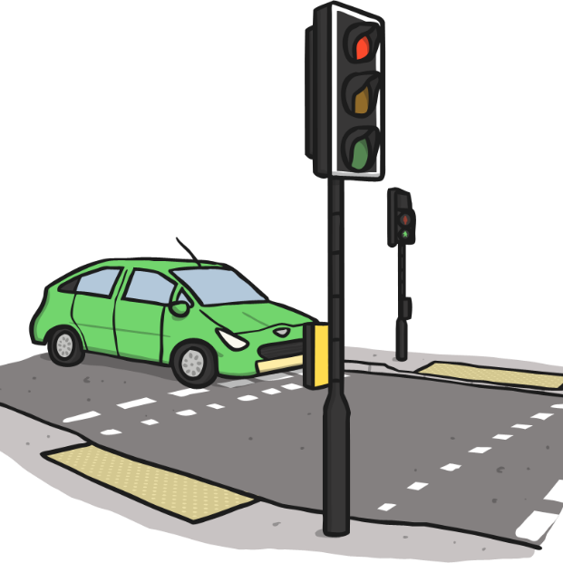
Road Safety
On some roads there are things to help you cross, like zebra crossings…
….or pelican crossings.

Slide 4
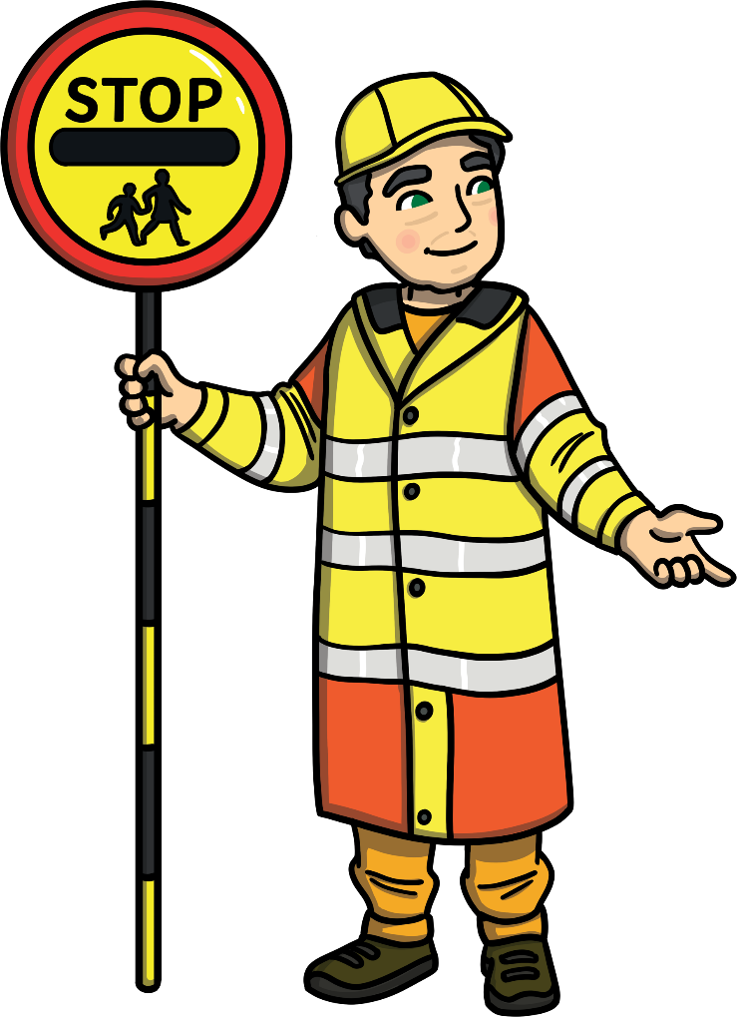
Road Safety
On some roads there are people to help you cross. The lollipop person will hold up a special sign to ask cars to stop so that people can cross the road safely.

Slide 5
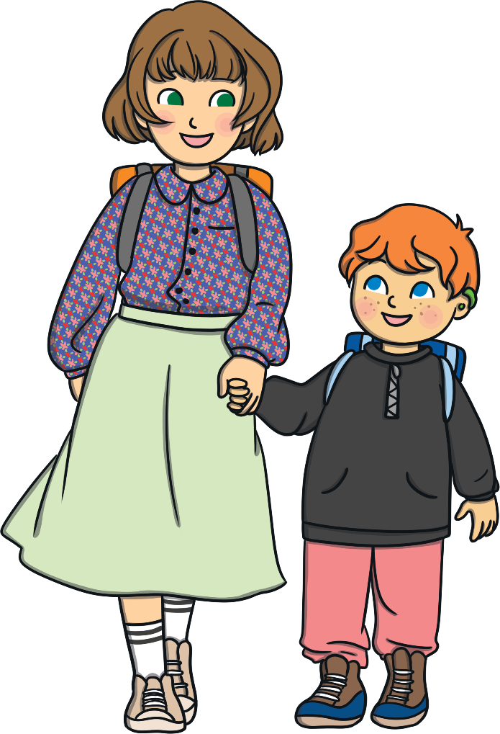
Road Safety
When walking with an adult, hold their hand – especially when you need to cross a road.

Slide 6

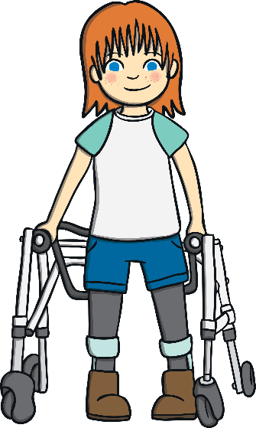
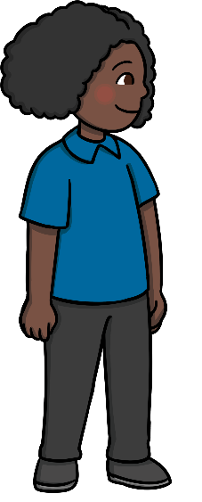
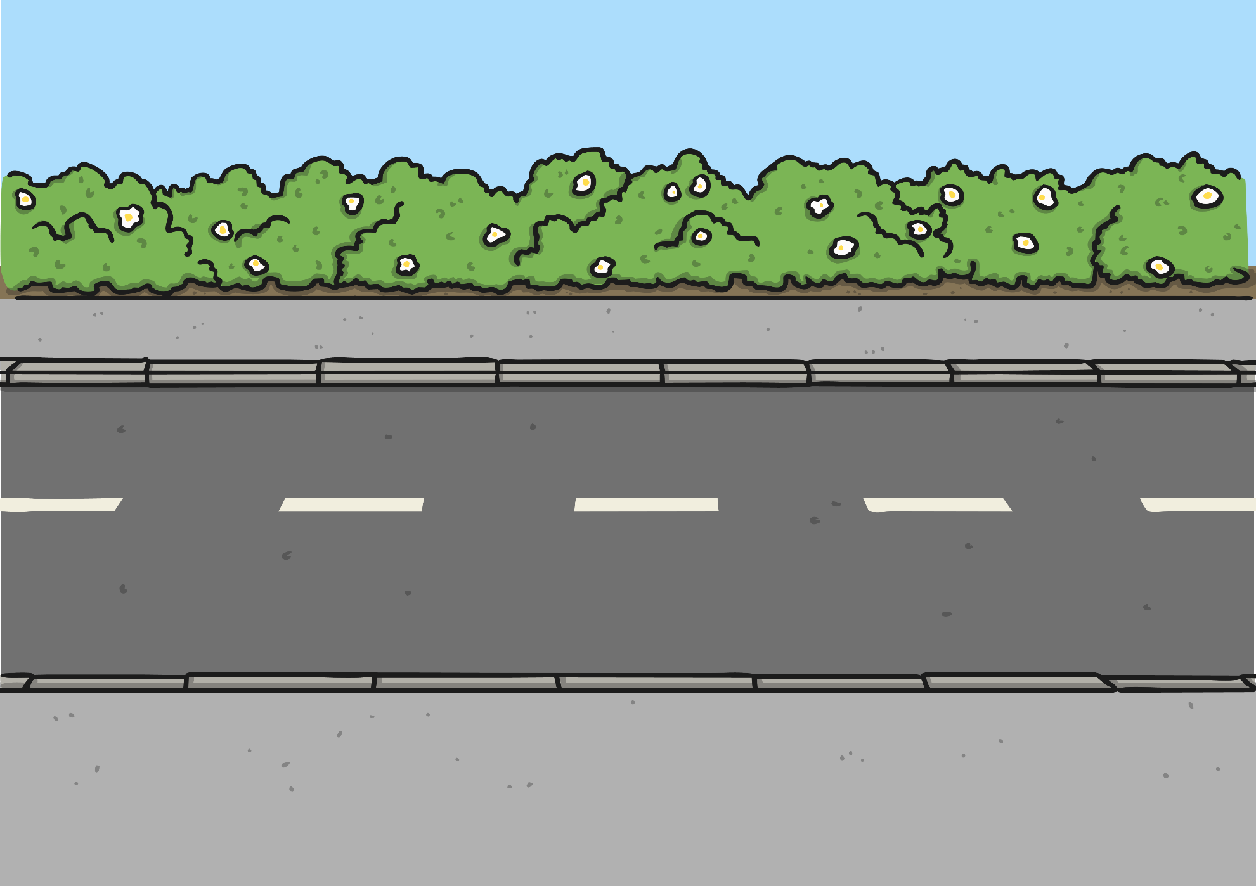
Road Safety
There are some special rules to follow to help you keep safe around roads.
Think about where you should cross.
Make sure you can see both ways along the road.

Slide 7
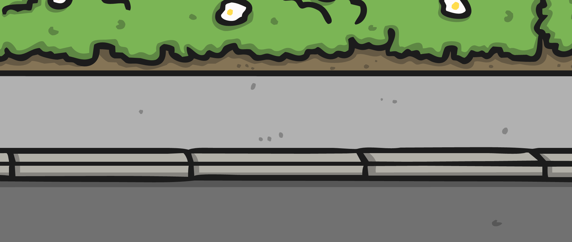


Road Safety
Stop at the side of the road.

Slide 8
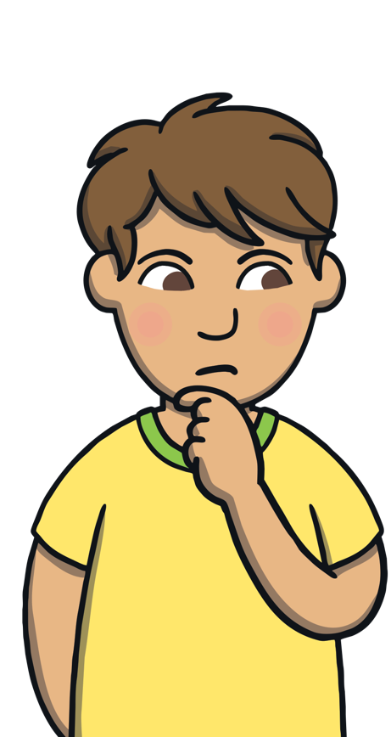

Road Safety
Look and listen to see and hear if any vehicles are coming.

Slide 9

Road Safety
Wait until the any vehicles have gone past.

Slide 10
Road Safety
Look and listen again to see and hear if any more vehicles are coming.

Slide 11
Road Safety
Cross the road – but keep looking and listening.

Slide 12

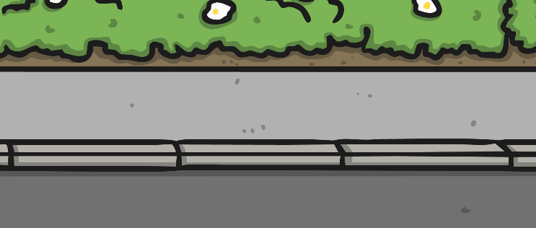




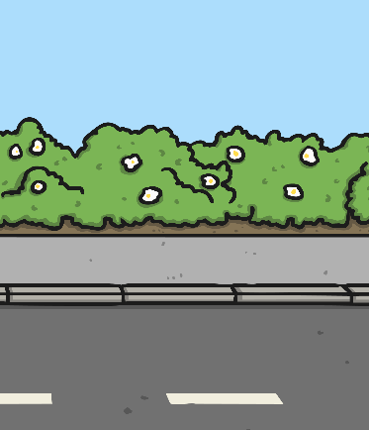


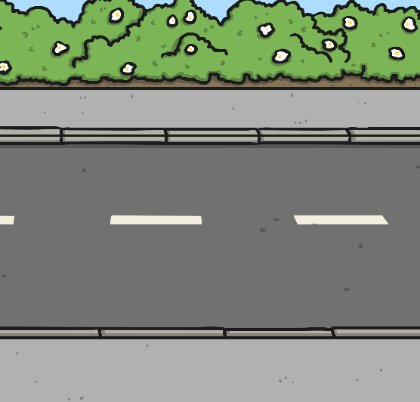




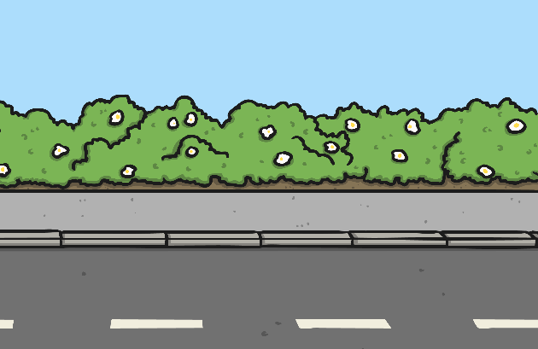

Road Safety
Can you remember how to cross the road safely?
2
3
1
6
4
5

