Slide 1
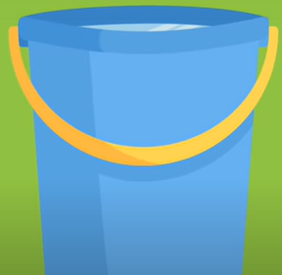
The Stress Bucket

Slide 2
What is stress
Our body’s natural response to feeling under pressure.
Everyone experiences stress.
Some amount of stress is normal and can help us achieve things like getting our homework done or speaking in class even though we might be nervous.
Too much stress can affect our mood, our body and our health.
Stress includes our worries, when we feel overwhelmed or anxious or when we feel cross or angry.
Learning to manage our stresses can improve our mental health.

Slide 3
The stress bucket metaphor can help us to understand!

Slide 4
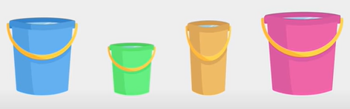
We all have different sized buckets
The size of our bucket represents our resilience and our capacity to cope with stress.

Slide 5
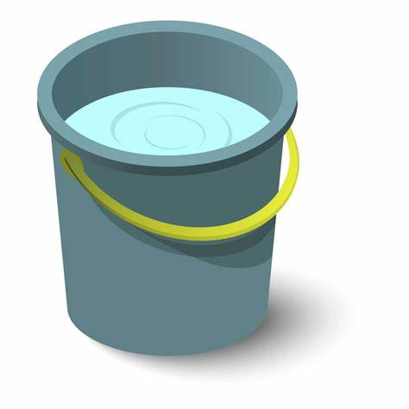
It is normal for our buckets to have some stress in them – we don’t start empty.
The amount we start with is different for everyone.

Slide 6

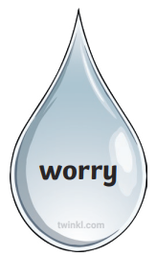
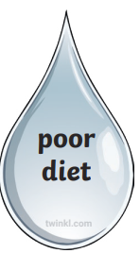
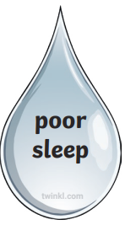
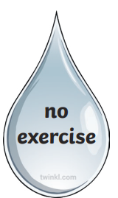
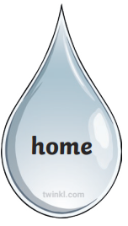
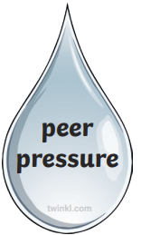

Over time, water is added to the bucket from different sources of stress or worry.
Some stresses might feel bigger than others
The type and size of stresses will feel different for everyone

Slide 7
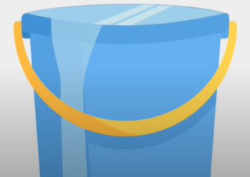
When the water level gets too high, our bucket overflows and we can feel stressed out and unable to cope with everyday life.

Slide 8
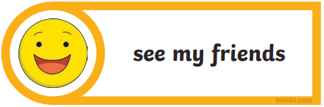
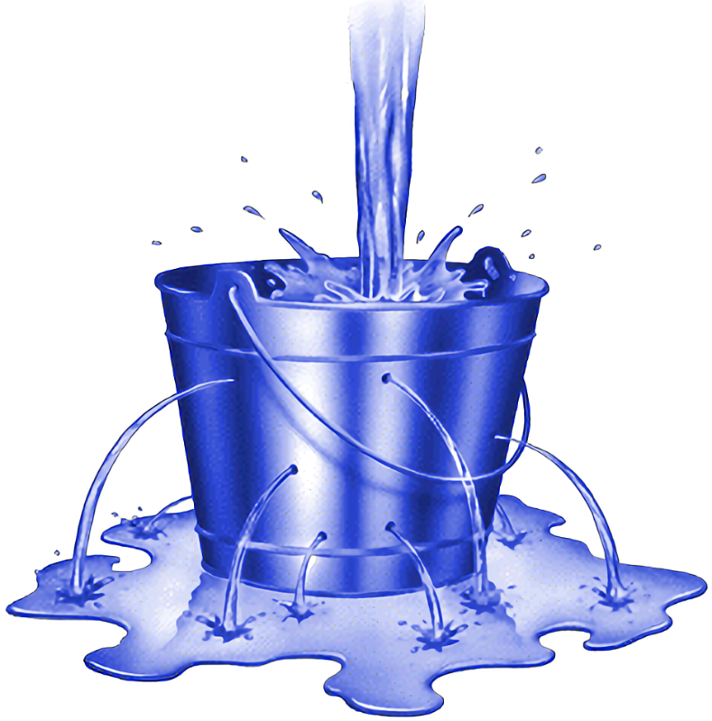
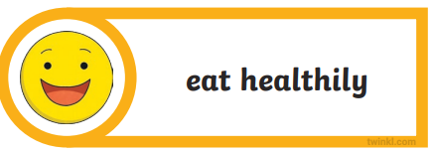
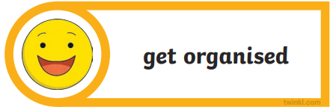
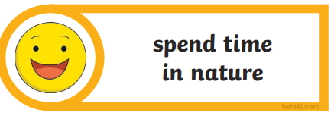
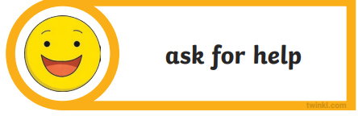
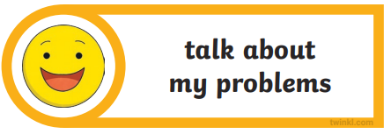
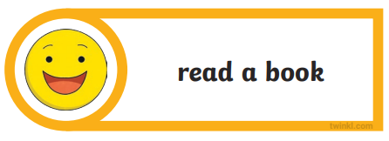

To keep the water level low and stop it from overflowing, we can make holes in our bucket to let out the water.
The ‘holes’ represent our coping strategies and ways of managing stress.

Slide 9
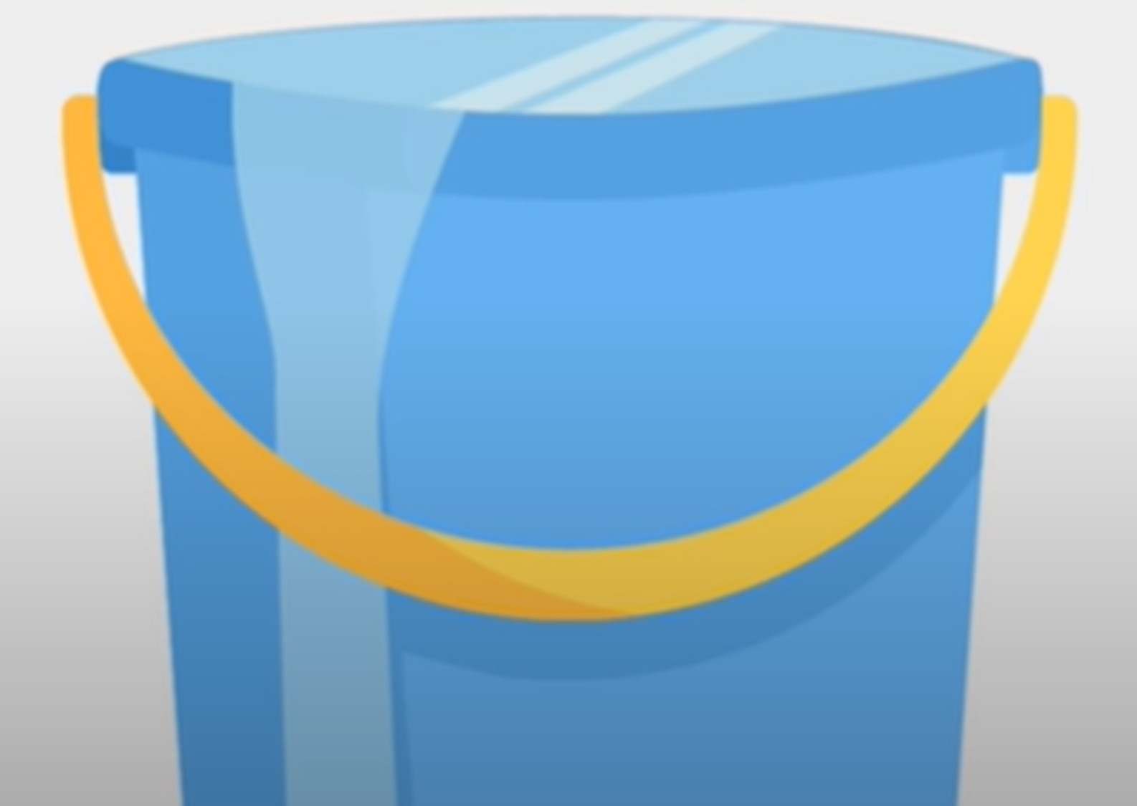
How full is your bucket?
What coping strategies can you try to make holes in your bucket?
You are not alone, ask for help.

